Slide 1
Effervescence
Empowering children to reach their potential

Slide 2
Effervescence :At a glance
“Effervescence” is not just a brand name. The name itself is self-explanatory. As talents or ideas are bubbling inside a student, longing for the opportunity to surface and emerge with full vigour when they get the escape velocity; we motivate the students to effervesce their potentials just as an effervescent liquid raises bubbles so that our aspirants can reach their goal with full confidence.

Slide 3
The Secret Sauce:
We provide chapterwise practice problems from various reputed books and coaching centres as well as our own customized study materials.
Chapter wise online mock test: The mock test will be in a cumulative manner. And a final test combining all the chapters for each subject to.
Class wise handouts with recorded video lectures: We shall provide class wise study materials, brief handouts (for easy understanding at home) and also provide class recording.

Slide 4
Advantages
Practice Problems
Handouts and Lectures
Mock Test
Doubt Clearing
Video solutions of practice sets to improve conceptual understanding.
Effective study plan to cover all the courses under the given time.

Slide 5
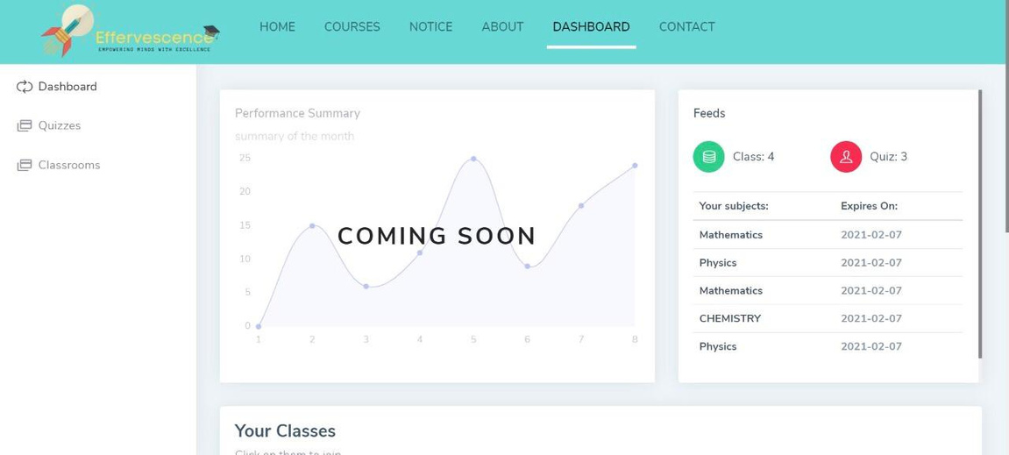
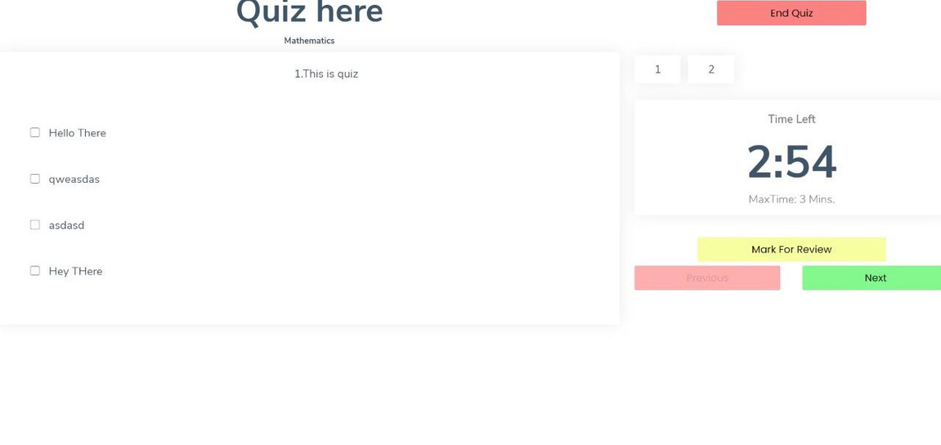
Practical Application

Slide 6


Slide 7
Tech stack:
Mongo DB, Express.js, React JS, Node.js
Design stack:
Material UI, Reactstrap

Slide 8
Future Ideas
- Interactive games based learning for kids
- Smart AI based attendance system
- AI based students performance analysis

Slide 9

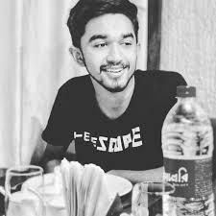

The Team - TBD
Anshika Pranzal
Debanshu Datta
Anu Agarwal
Kalinga Institute of Industrial Technology
Kalinga Institute of Industrial Technology
Kalinga Institute of Industrial Technology
Computer Science and Communication
Computer Science and Communication
Information Technology
1829041
1829013
1806545

